Slide 1
TELECOM CUSTOMER
CHURN PREDICTION
Presented by,
Akshay Kulkarni
Guided by,
Mr. Harikrishnan V S

Slide 2
CONTENT
ABOUT PROJECT
PROBLEM STATEMENT
ABOUT DATASET
TECHNOLOGY USED
DATA VISUALIZATION
DEVELOPMENT
CONCLUSION

Slide 3
ABOUT PROJECT
Customer churn is defined as when customers or subscribers discontinue doing business with a firm or service
Customer churn is a critical metric because it is much less expensive to retain existing customers than it is to acquire new customers
To reduce customer churn, telecom companies need to predict which customers are at high risk of churn.
When it comes to useful business applications of machine learning, it doesn’t get much better than customer churn prediction. It’s a problem where you usually have a lot of high-quality, fresh data to work with, it’s relatively straightforward, and solving it can be a great way to increase profits.
Churn rate is a critical metric of customer satisfaction. Low churn rates mean happy customers; high churn rates mean customers are leaving you.

Slide 4
PROBLEM STATEMENT
In the dynamic telecom industry, customer satisfaction is paramount, with services like communication and internet being integral to daily life.
However, a single negative experience can lead to customer churn, significantly impacting revenue.
The challenge lies in predicting and mitigating churn through effective analysis and strategic interventions.
This necessitates the development of predictive models and comprehensive reports to guide decision-making, improve service quality, and foster long-term customer trust and retention.

Slide 5
ABOUT DATASET
We have collected our dataset from Kaggle’s Official Website.
Customer: Customer ID unique for each customer
gender: Whether the customer is a male or a female
SeniorCitizen: Whether the customer is a senior citizen or not (1, 0)
Partner: Whether the customer has a partner or not (Yes, No)
Dependent: Whether the customer has dependents or not (Yes, No)
PhoneService: Whether the customer has a phone service or not (Yes, No)
MultipeLines: Whether the customer has multiple lines or not (Yes, No, No phone service)
InternetService: Customer’s internet service provider (DSL, Fiber optic, No)
OnlineSecurity: Whether the customer has online security or not (Yes, No, No internet service)

Slide 6
ABOUT DATASET
OnlineBackup: Whether the customer has an online backup or not (Yes, No, No internet service)
DeviceProtection: Whether the customer has device protection or not (Yes, No, No internet service)
TechSupport: Whether the customer has tech support or not (Yes, No, No internet service)
StreamingTV: Whether the customer has streaming TV or not (Yes, No, No internet service)
StreamingMovies: Whether the customer has streaming movies or not (Yes, No, No internet service)
Contract: The contract term of the customer (Month-to-month, One year, Two years)
PaperlessBilling: The contract term of the customer (Month-to-month, One year, Two years)

Slide 7
ABOUT DATASET
PaymentMethod: The customer’s payment method (Electronic check, Mailed check, Bank transfer (automatic), Credit card (automatic))
Next, there are 3 numerical features:
Tenure: Number of months the customer has stayed with the company
MonthlyCharges: The amount charged to the customer monthly
TotalCharges: The total amount charged to the customer
Prediction feature:
Churn: Whether the customer churned or not (Yes or No)

Slide 8
TECHNOLOGY USED FOR PROJECT
Programming Language | Python
Python Libraries | NumPy, Pandas, missingno, warning
Data Visualization | Matplotlib, Seaborn, Scipy, Tableau
Machine Learning Algorithms | Logistic Regression , Decision Tree ,Random Forest Support Vector Machine (SVM) , XG-Boost Artificial Neural Network
Imbalanced Dataset Handling Technique | SMOTE (Synthetic Minority Over-sampling Technique)
Hyperparameter Turning | GridSearchCV
Machine Learning Library | Scikit-learn

Slide 9
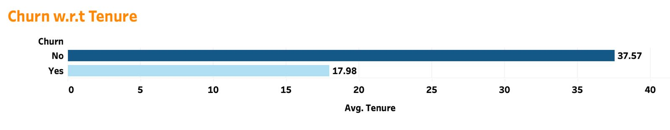
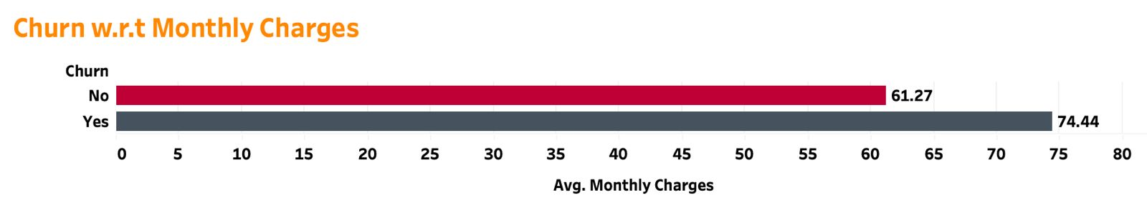
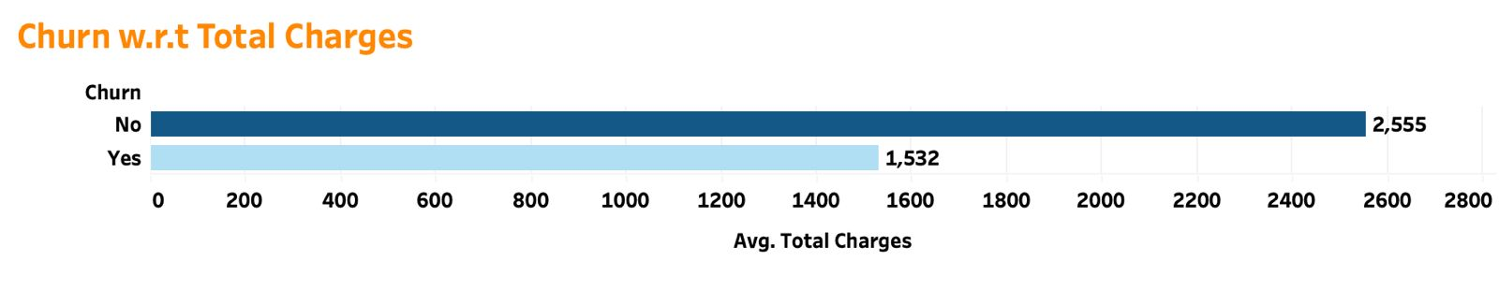
DATA VISUALIZATION

Slide 10
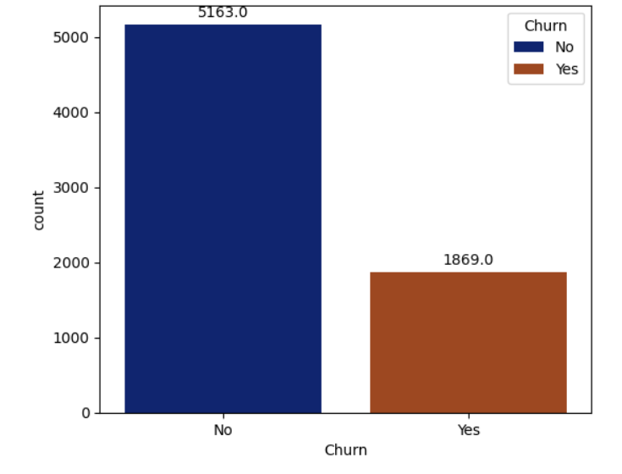
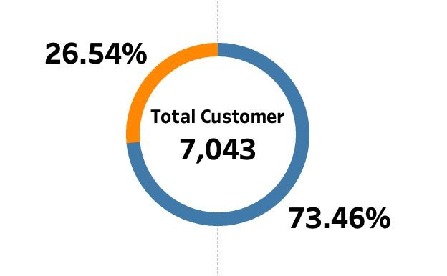
DATA VISUALIZATION

Slide 11
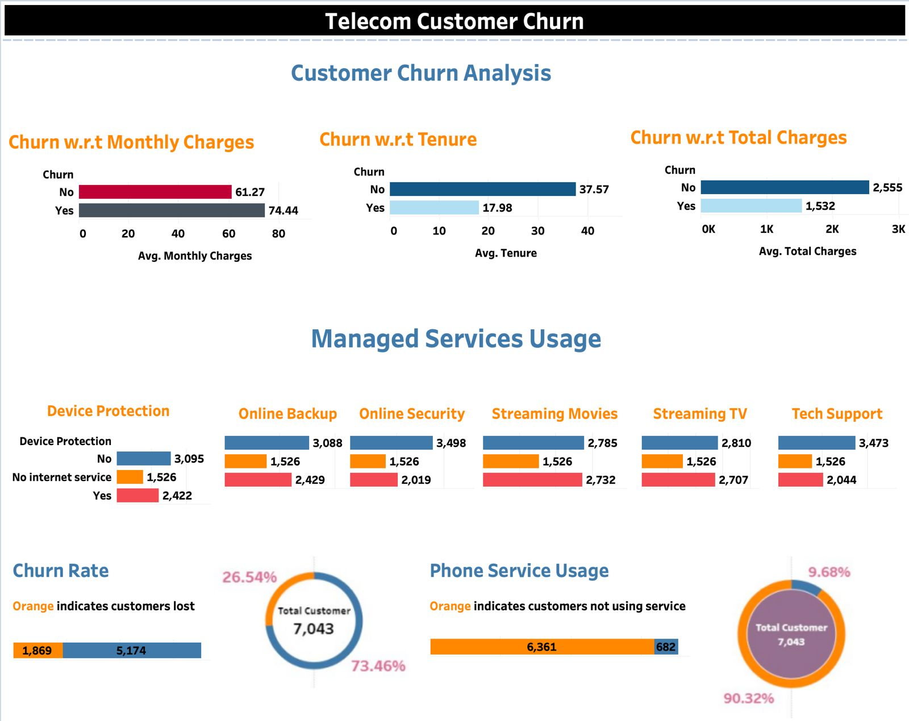

Slide 12
DEVELOPMENT AND CODING
Data Collection
Data Pre-Processing
Data Visualization
Feature Scaling
Model Training
Model Evaluation

Slide 13
DEVELOPMENT AND CODING
For our project, we have used following Algorithms seek performance measures :
Logistic Regression
Decision Tree
Random Forest
Support Vector Machine (SVM)
XG-Boost
Artificial Neural Network

Slide 14
DEVELOPMENT AND CODING
After training and testing the model we have got following outputs :-
M.L. Algorithm | Accuracy | Precision | Recall | F1-Score
Logistic Regression | 80% | 83% | 76% | 79%
Decision Tree | 79% | 80% | 79% | 80%
Random Forest | 82% | 85% | 78% | 81%
Support Vector Machine | 80% | 83% | 75% | 79%
XGBoost | 83% | 85% | 81% | 83%
ANN | 82% | 84% | 81% | 82%

Slide 15
DEVELOPMENT
To improve model Accuracy, we have use Hyperparameter Tunning Technique.
The best strategies for Hyperparameter tuning are:
GridSearchCV
RandomizedSearchCV
Bayesian Optimization
We have used GridSearchCV Technique for our project.
M.L. Algorithm | Accuracy | Precision | Recall | F1-Score
Random Forest | 84% | 85% | 84% | 84%
XGBoost | 84% | 85% | 83% | 84%
After Using GridSearchCV

Slide 16
CONCLUSION
In summary, this project successfully tackled the challenge of predicting customer churn in the telecom industry through the implementation of a machine learning model.
By cleaning the dataset, conducting exploratory data analysis, and employing six different models, we identified XGBoost as the top performer in terms of accuracy and F1-score.
Furthermore, our success in enhancing model performance through hyperparameter tuning underscores the critical role of optimization techniques in maximizing predictive capabilities.
Overall, this project highlights the efficacy of employing advanced machine learning methodologies to address real-world business challenges such as telecom churn prediction.

Slide 17
Thank You…!!

